Slide 1

FRONT END ENGINEERING-1
PROJECT 1
TEAM DETAILS
S NO. NAME ROLL NO.
Kashish 2310990792
Kashvi 2310990793
Kavya 2310990794
Submitted to-
Faculty name- Ms. Gunjan Thakur
Designation- Teacher
Chitkara University Rajpura, Punjab

Slide 2
INTRODUCTION
Welcome to the exciting world of Eat 24 c , a revolutionary food ordering site that is set to transform the way people experience and enjoy their favourite meals. In an era defined by convenience, speed, and the desire for diverse culinary experiences, Eat 24 emerges as the ultimate solution for all your food cravings.
This project is the culmination of meticulous planning, cutting-edge technology, and a deep passion for gastronomy. As the world becomes increasingly interconnected, the demand for seamless and efficient food ordering platforms has never been higher. Eat 24 aims to meet this demand by providing a user-friendly, efficient, and delightful food ordering experience for customers and an effective platform for restaurants to expand their reach and grow their business.
In this project file, we will delve into the details of Eat 24, exploring its objectives, features, development process, and the vision behind this endeavor. From understanding the market dynamics to dissecting the technical architecture, this document will serve as a comprehensive guide to our journey in creating an exceptional food ordering platform.
Let's embark on this culinary adventure together and discover how eat 24 is poised to redefine the way we order, saviour, and share our favourite meals. Get ready to experience the future of food ordering !

Slide 3
TABLE OF CONTENT
INTRODUCTION
PROBLEM STATEMENT
TECHNICAL DETAILS
KEY FEATURE PROJECT HIGHLIGHTS
CONCLUSION

Slide 4
PROBLEM STATEMENT
In today's fast-paced and digitally-driven world, the traditional methods of ordering food have become increasingly inconvenient and outdated. Customers often encounter a myriad of challenges when attempting to satisfy their culinary cravings, while restaurants face hurdles in efficiently managing orders and expanding their customer base. These challenges include:
Limited Accessibility: Many potential customers are unable to access a diverse range of culinary options due to geographical constraints or lack of information about local restaurants.
Inefficient Ordering Process: The current food ordering process often involves long wait times on the phone, miscommunication, and order inaccuracies, leading to a frustrating customer experience.
Limited Payment Options: Traditional food ordering methods often offer limited payment options, which can be inconvenient for customers who prefer digital transactions.
Lack of Menu Information: Customers may struggle to access detailed menu information, including ingredients, nutritional content, and special dietary options, leading to uncertainty and dissatisfaction.
Inadequate Restaurant Management Tools: Restaurants face difficulties in efficiently managing orders, tracking inventory, and analyzing customer data, hindering their growth and profitability.
Market Fragmentation: The food industry is highly fragmented, with restaurants operating independently and lacking a unified platform to reach a wider customer base.
Lack of Personalization: Current food ordering methods often fail to provide personalized recommendations and experiences tailored to individual customer preferences.

Slide 5
TECHNICAL DETAILS
WEB DEVELOPMENT STACK- IN Eat 24 we have recently used html and CSS in front end and later we will be going on with the java script and python in backend
USER INTERFACE-we have created a responsive and a user friendly food ordering website
MENU MANAGEMENT- In our menu we have provided various options for user such as north Indian, south Indian, snacks, chai and coffee, ice cream, fast food
ORDERING SITE-In our website till we are providing the facility of the cash on delivery to the user and later on we will be providing options for online delivery also
RATING AND REVIEWS- After visiting our website please share your ratings so that we can improve our website for the next time and give user the best experience
MOBILE APP- Till now we are available at website only but soon we will be providing online ordering app to our users

Slide 6
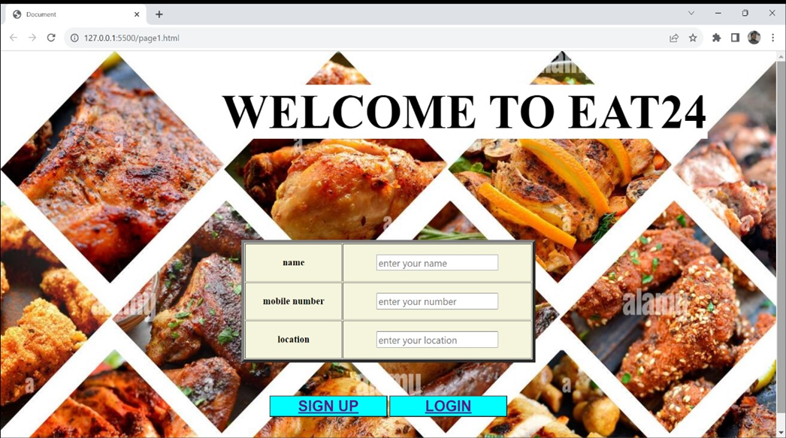
PROJECT HIGHLIGHTS

Slide 7
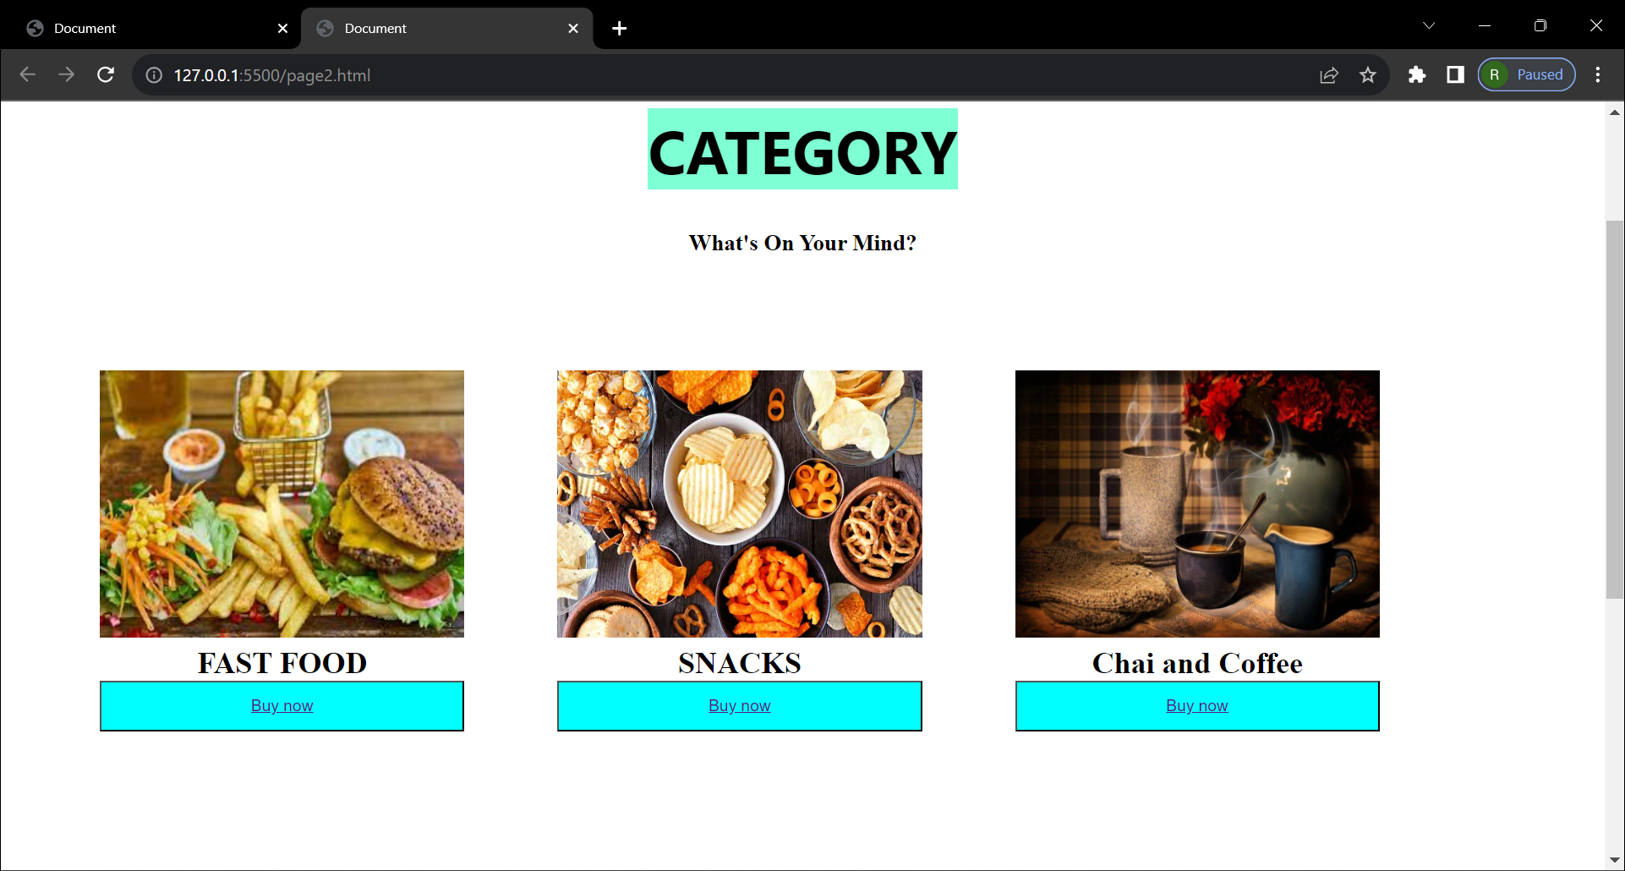

Slide 8
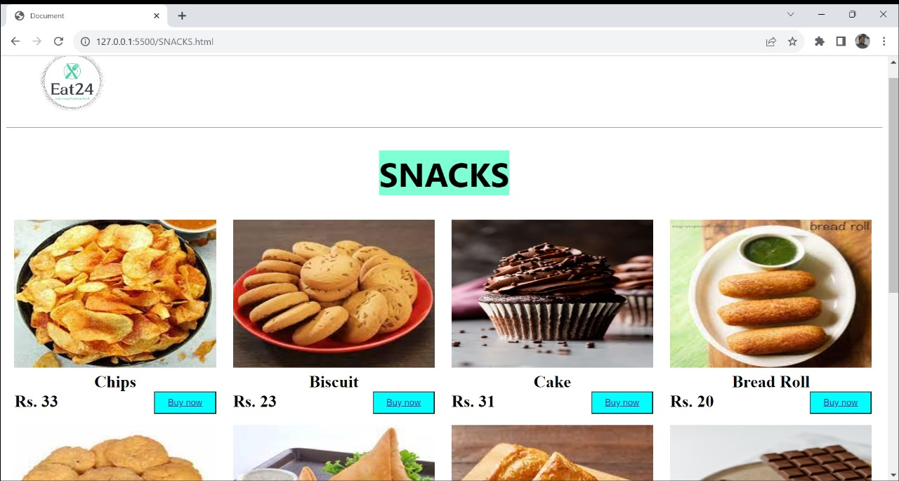

Slide 9
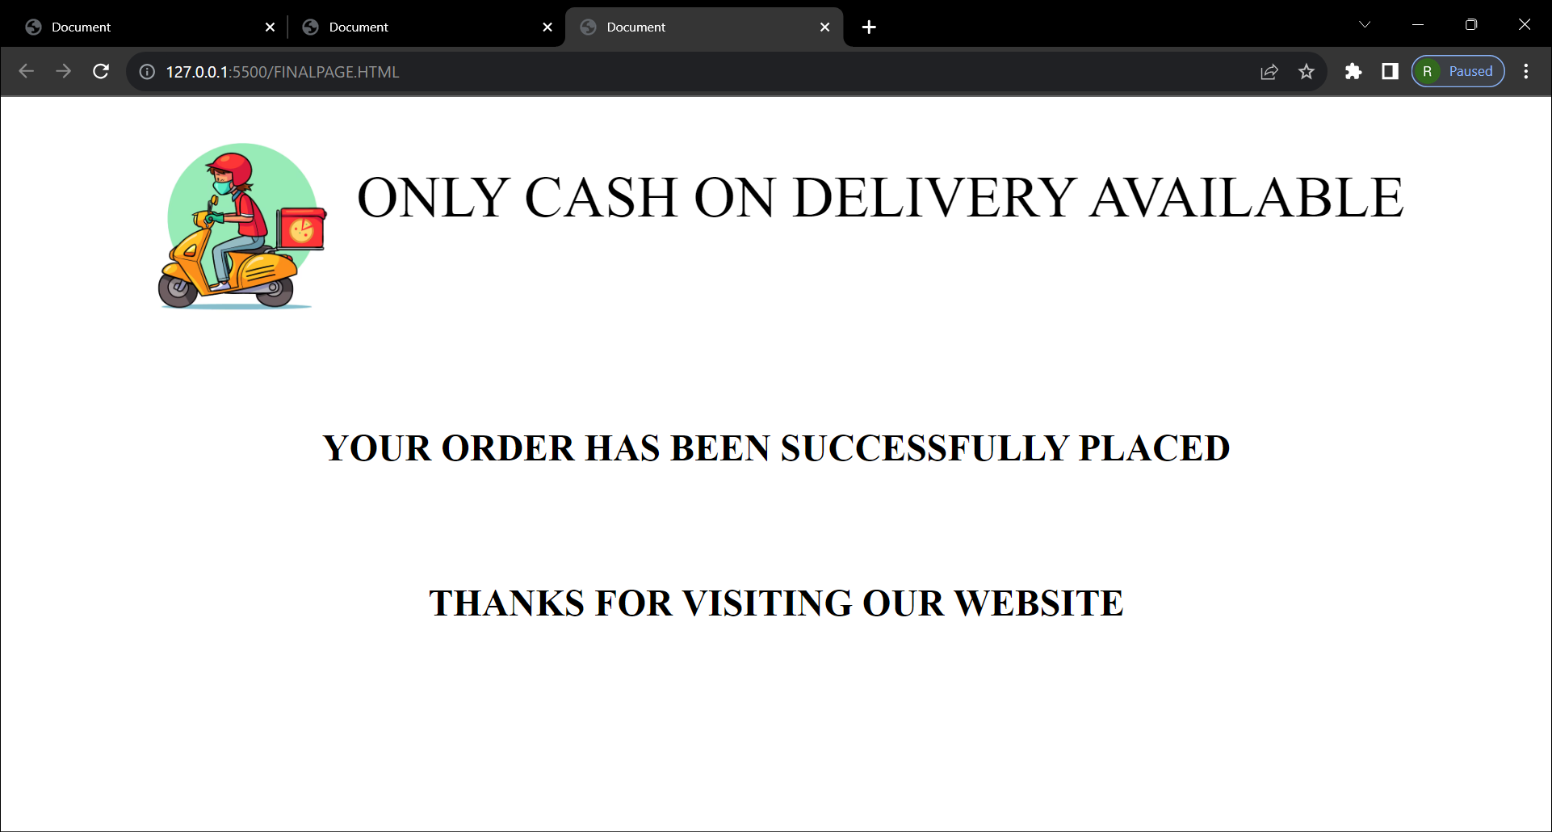

Slide 10
CONCLUSION
In conclusion, our food ordering site project, Eat 24, represents a significant leap forward in the culinary industry, addressing critical challenges faced by both customers and restaurant owners. Throughout this endeavor, we have harnessed technology and innovation to create a robust and user-friendly platform that redefines the food ordering experience.
By focusing on solving the problems associated with traditional food ordering methods, we have provided a comprehensive solution. Customers can now effortlessly explore menus, customize orders, and make secure payments while enjoying personalized recommendations and real-time notifications. On the other hand, restaurant owners benefit from an efficient inventory management system, data analytics insights, and a unified platform to reach a wider customer base.
Eat 24 is not just a food ordering site; it's a culinary journey that combines the love for food with cutting-edge technology. It is our vision to connect people with their favorite meals in a way that is accessible, convenient, and enjoyable. We are excited to see Eat 24 flourish and make a positive impact on the food industry, bringing joy and satisfaction to both customers and restaurant owners alike.
We extend our gratitude to all the stakeholders, team members, and partners who have been part of this project, and we look forward to a future filled with culinary delights and technological excellence.

Slide 11


